Slide 1
USPS REDESIGN ROUNDTABLE
AUGUST 14TH, 2025
PRESENTED BY
SSA PAYROLL TEAM

Slide 2
Agenda
Introduction
New Contracts
Mass Copy
Import
Reports
Using the Grid
Salary Notices
Mid-Year Contract Changes
Break
Payables
Set up of payables(CONFIG)
Timing
Processing Outstanding Payables
Questions/Open discussion

Slide 3

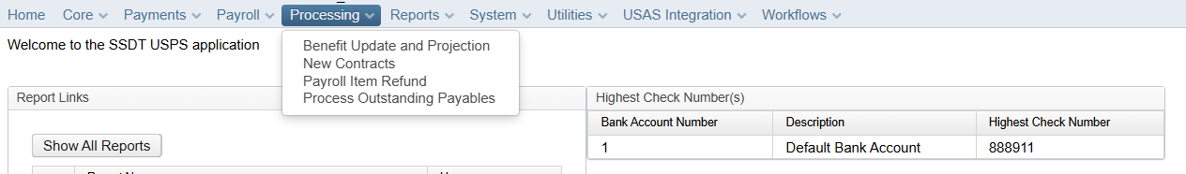
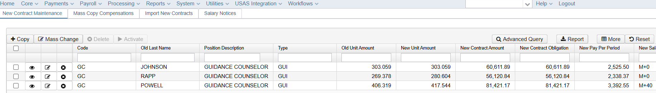
New Contracts
***HOLDING AREA, until Activated****

Slide 4
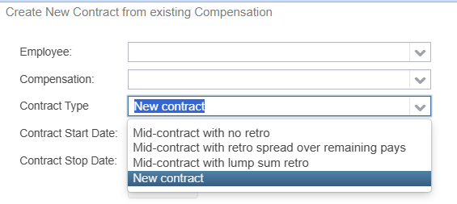
Copy – Creation of a “New Contract”
What TYPE of “New Contract” are you creating??
Employee must already be in the system AND have a Compensation Record.
Compensation Records that have been ARCHIVED will not appear as an option in New Contract
Pick Wisely what TYPE of New Contract you are adding.
Make sure you SELECT the Correct Employee Compensation Record to be updated
Contract Start and Contract Stop Dates are REQUIRED (Contract Stop Date Should be one day prior to NEXT Year’s Start Date)
Contract START date should be the FIRST day for which this job is paid.

Slide 5
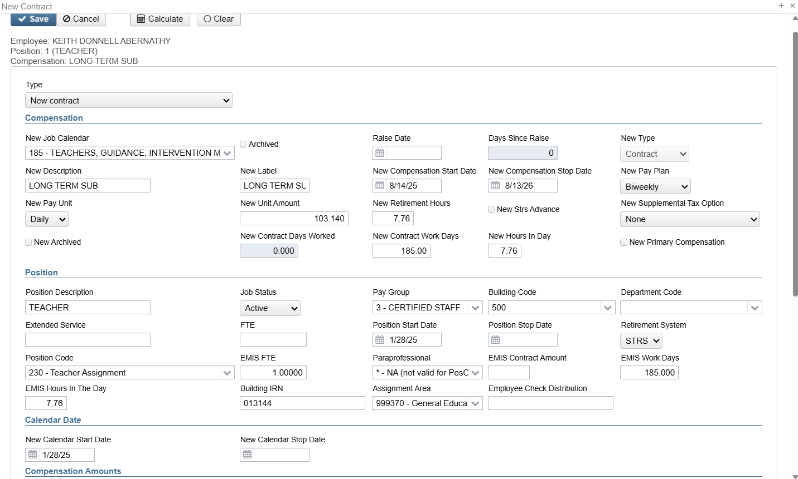
Copy- New Contract
Brings in Information from Current Contract
Clear Feature can remove info that needs to be updated

Slide 6
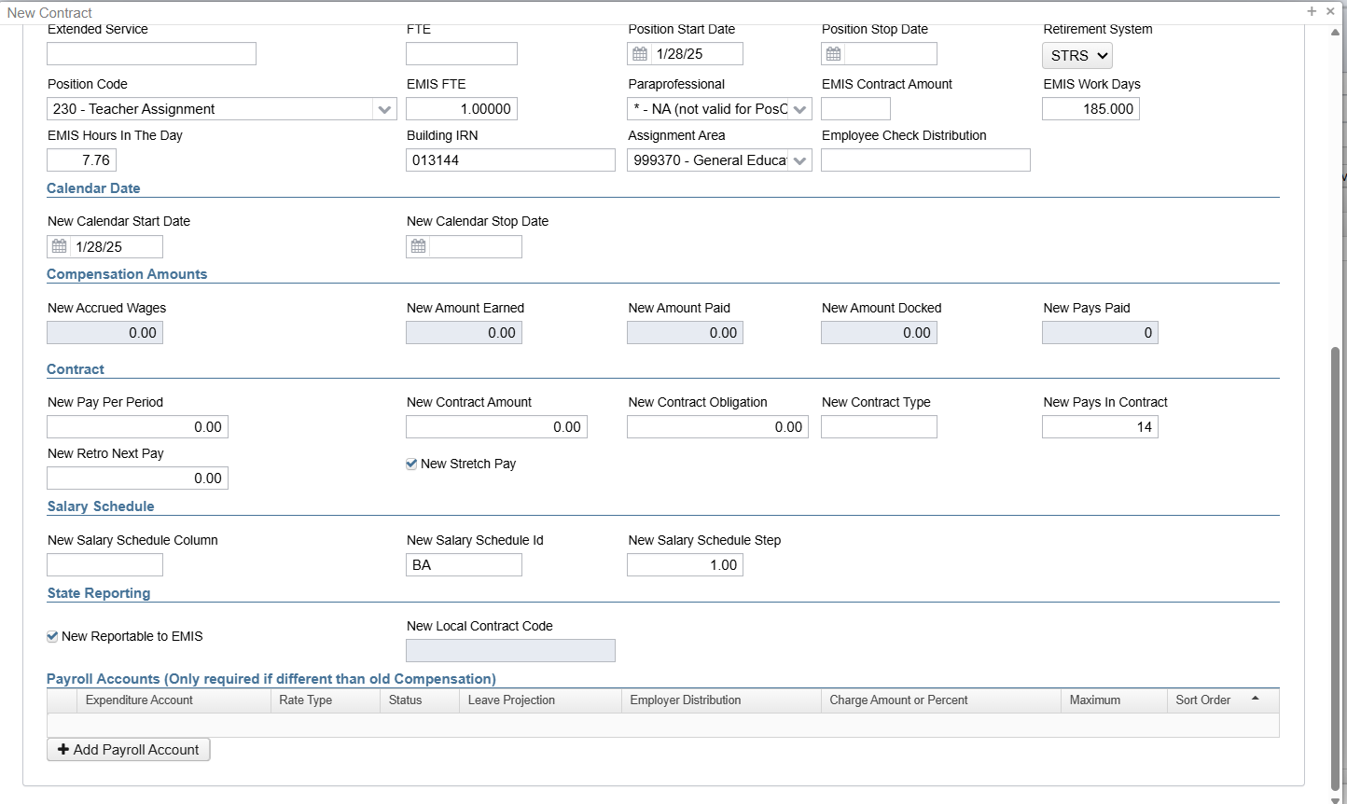
Copy- New Contract
New Contract Amount, Work days & New Pays should be entered/verified
<-Optional

Slide 7
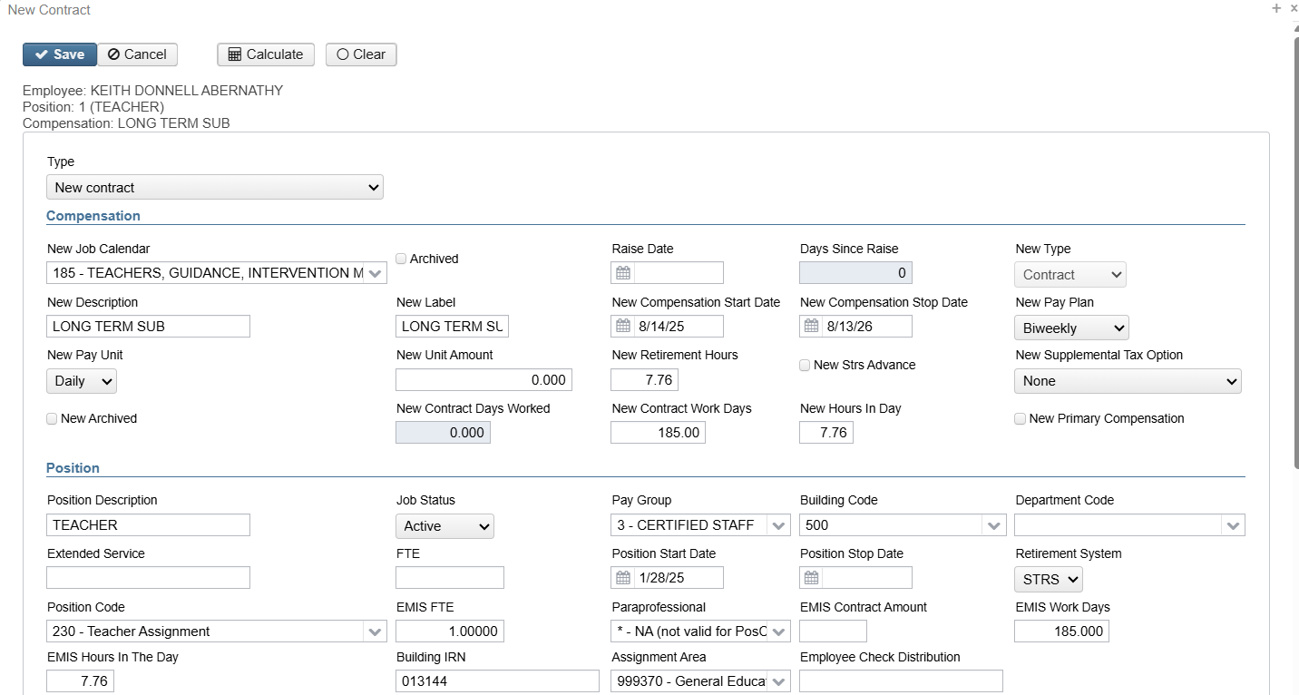
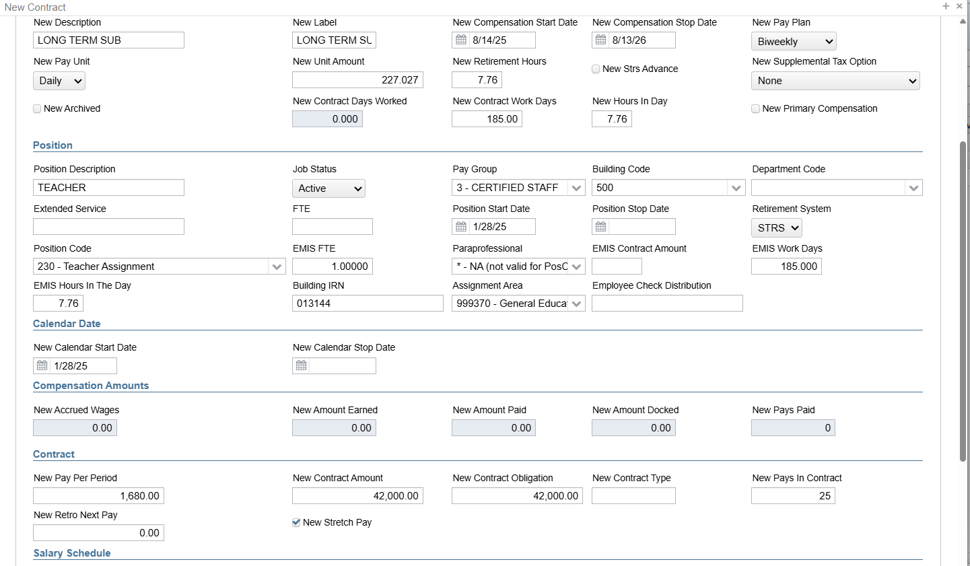
Copy- New Contract
CALCULATE option will fill in fields…SAVE will NOT
If checked, will ARCHIVE old Compensation
Should KNOW what you expect the amounts to be

Slide 8
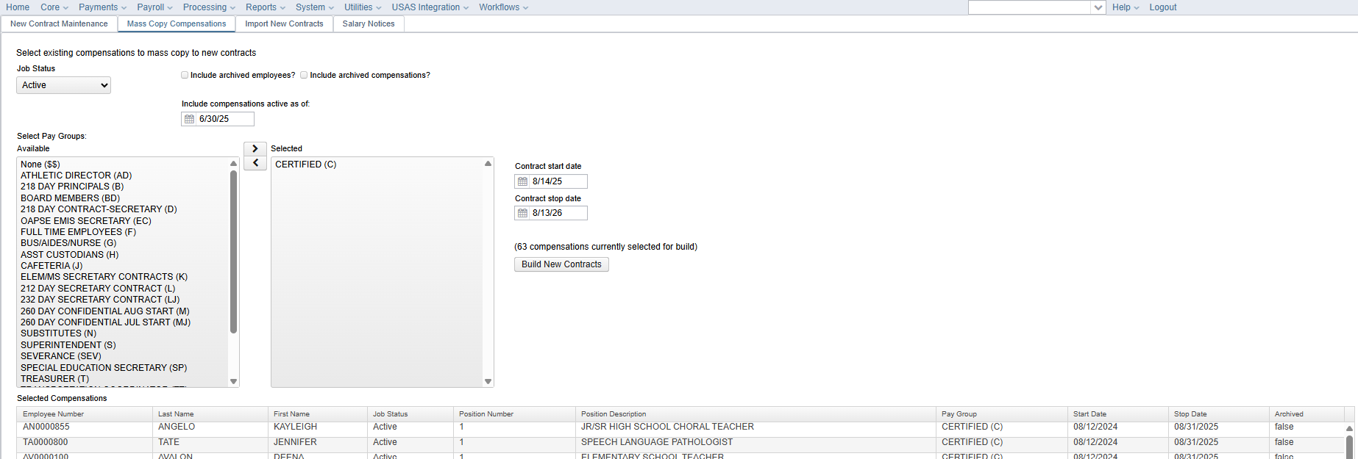
MASS COPY used to “build” New Contracts
Include Compensation ACTIVE as of..
Select Pay Group you would like to “Build”
Enter Contract Start & Stop Dates
Number of Contracts to be “built” will appear
BUILD New Contracts
Will Populate New Contract Maintenance
Can then Run Reports, Create an Excel Sheet for Updating and Importing
Can Directly Update in New Contract Maintenance
Can also be used to BUILD spreadsheets for balancing
Can DELETE entire Group if not wanted

Slide 9
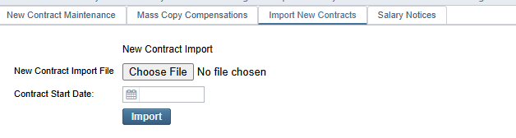
IMPORT
New CONTRACTS
Must have a .csv FILE (No formulas, No symbols, only values)
Data columns must contain a HEADING in Row 1
Header names are case sensitive
3 Required Fields: employeeId, jobNo, contractType (4)
Can create a template spreadsheet from current compensations
  New Contract Compensation Worksheet.rpd-json
  Can select by Pay Group and create an Excel Sheet
  Helps to know Current Start & Stop Dates
Can Import and DELETE as often as you want
Handout of field names and descriptions
If a field is NOT imported, the old value will remain

Slide 10
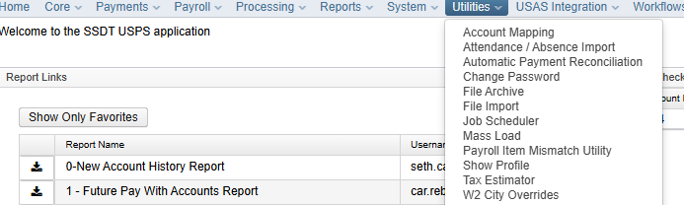
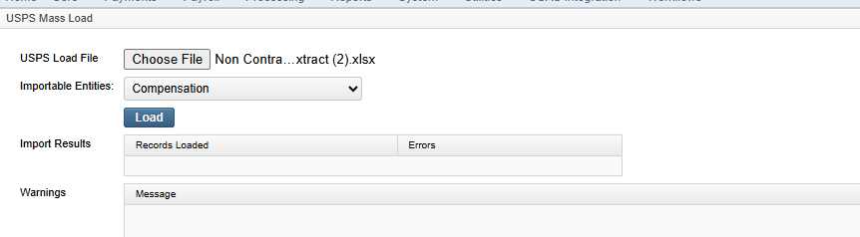
Create New
Non-Contract Comps
Go to Reports/Report Manager
Locate SSDT Non-Contract Compensation Mass Load Extract
Will provide an EXCEL sheet with appropriate headers to Mass Load non-contract Compensations
Can FILTER the Excel Sheet to only LOAD those non-contract employees with updated rates for this year
Use Utilities/ Mass Load
Importable Entities -> Compensation

Slide 11
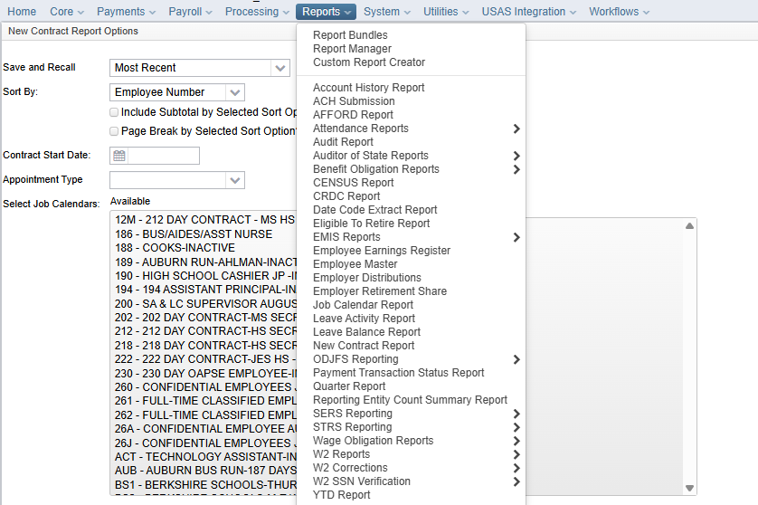
REPORTS from Reports Manager
Go to Reports
On initial page is NEW Contract Report
Will bring up an Options page
  Can sort by Employee #, Name, Pay Group, Contract Start Date, Number of Pays, Number of Days, Job Calendar
  Can Subtotal or Page Break by the Sort you select
  Can Select Specific Contract Start Dates or Appointment types
Select IF you only want Specific Job Calendars or Specific Pay Groups

Slide 12
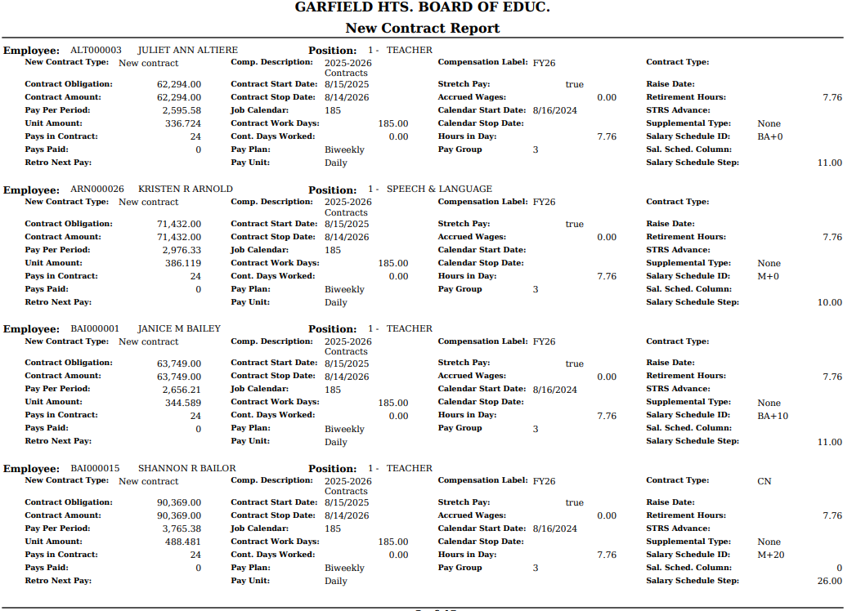
REPORTS

Slide 13
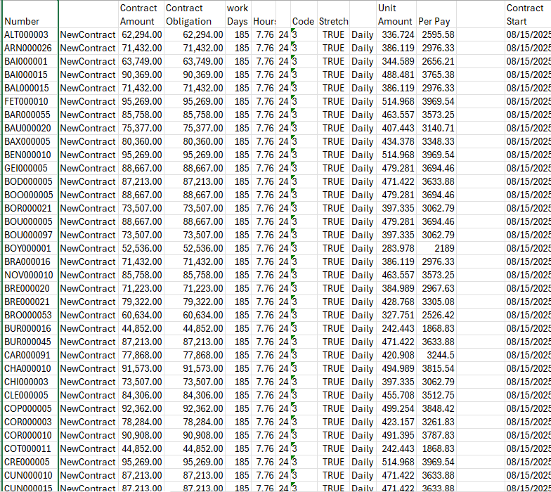
REPORTS
Custom Reports can also be made
Use one of the created Reports as a base and Modify
Use the HELP Tab
  Public Shared Reports Library

Slide 14
REPORTS from the GRID

Slide 15
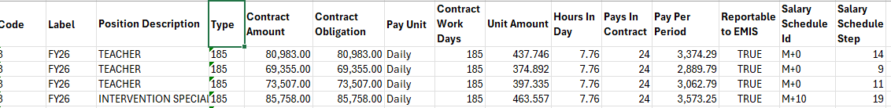
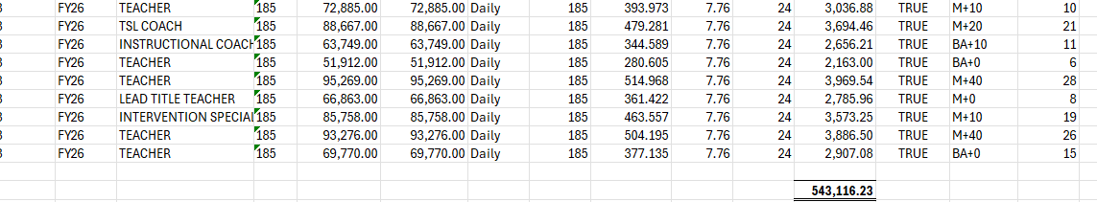
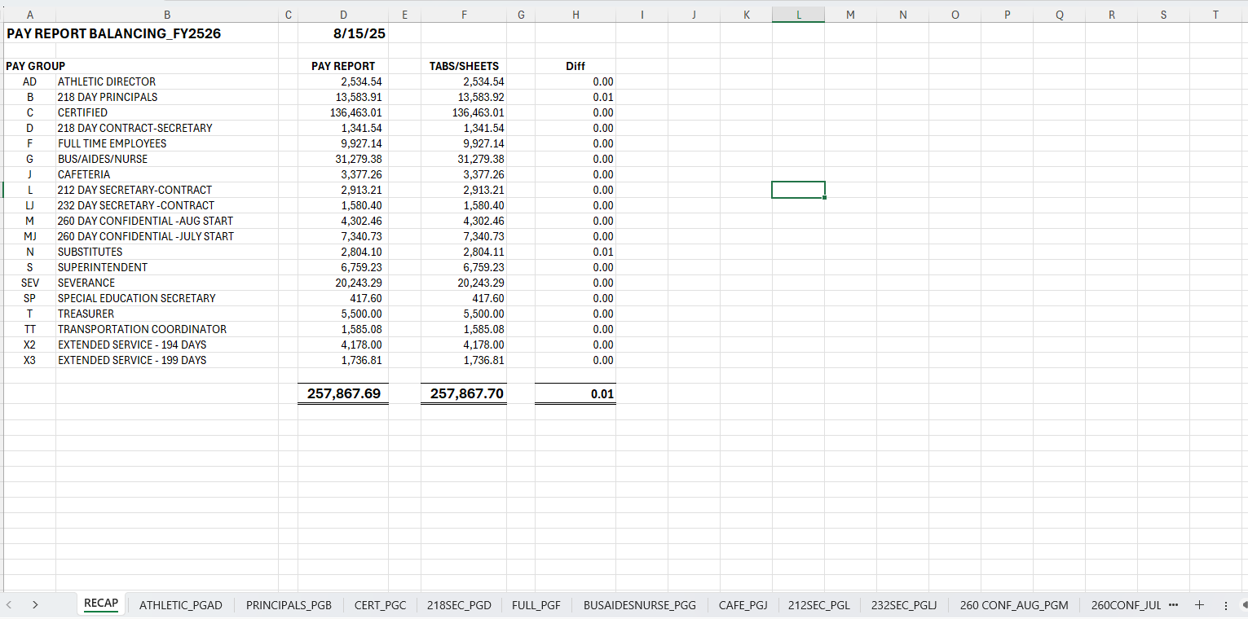
REPORTS from the GRID (can also use for balancing)

Slide 16
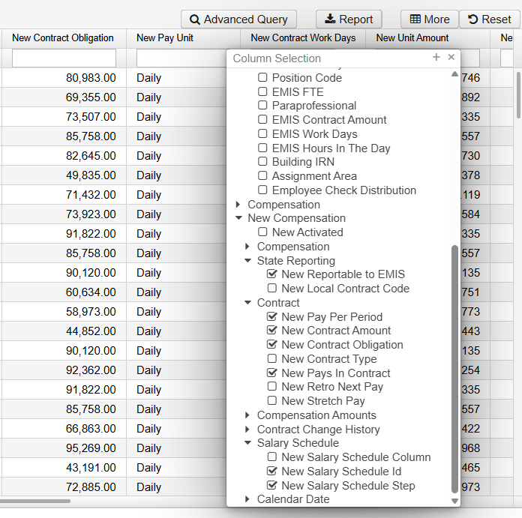
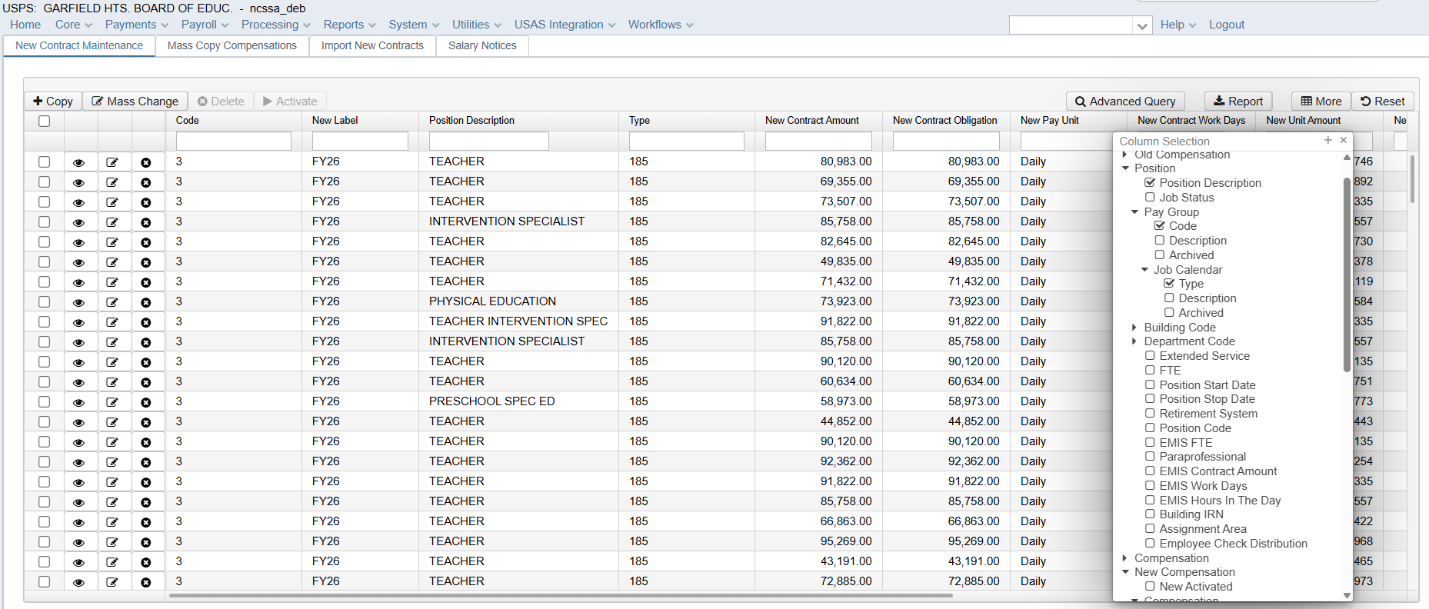
USING THE GRID

Slide 17
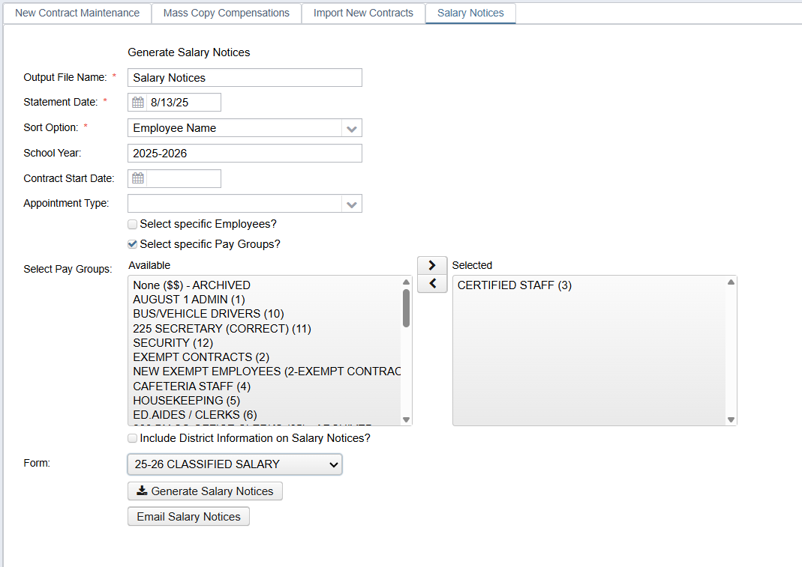
Salary Notices

Slide 18
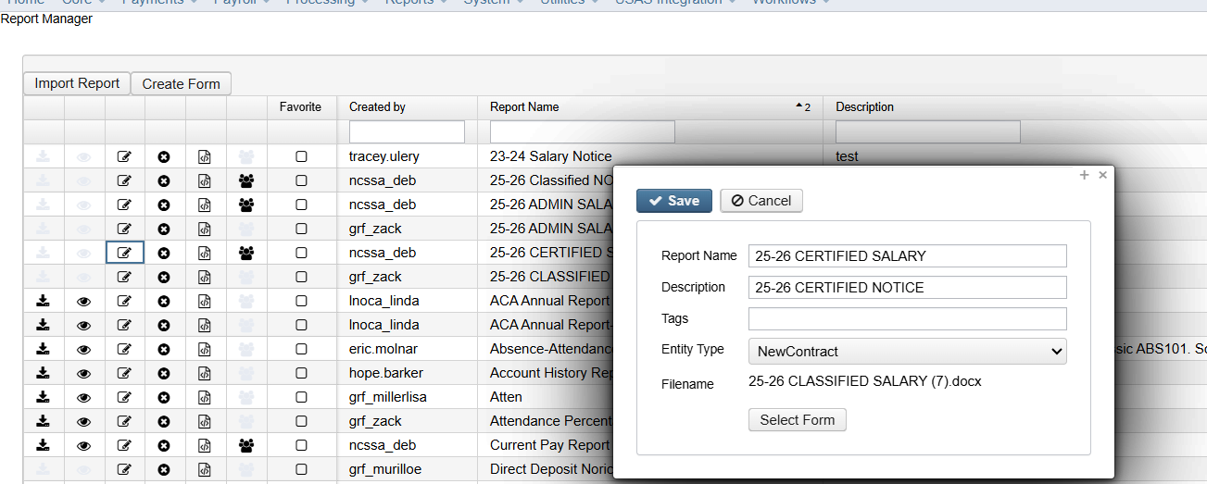
Salary Notices

Slide 19
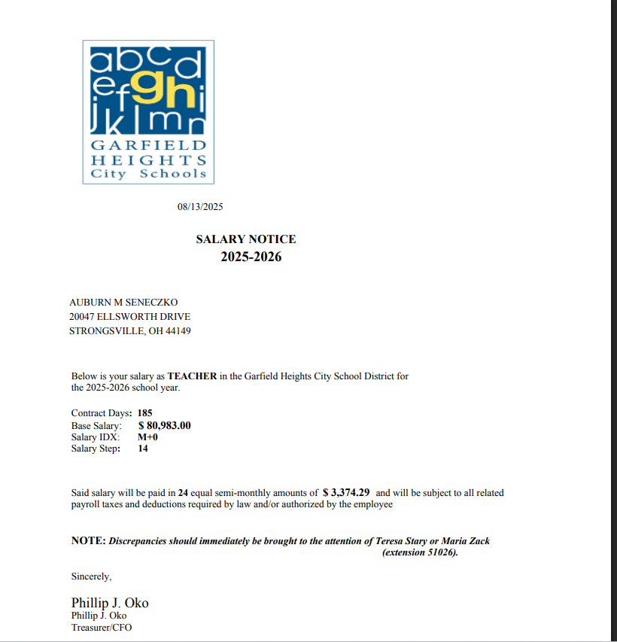
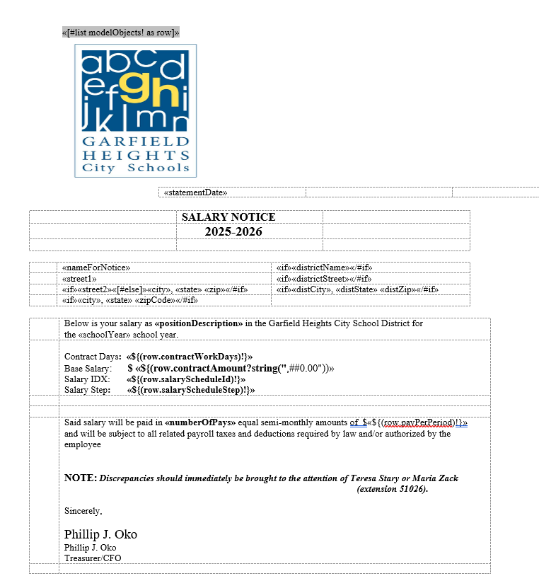
Salary Notices

Slide 20
Let’s talk
ACTIVATE
New Contracts
Contract
Fulfilled
STRS
Should be ACTIVATED BEFORE
The 1st WORK day of New Contract
Even if there is one (1) pay left
Days Worked
Counted

Slide 21
MID-Year Contract
CHANGES
With NO Retro
With LUMP Sum Retro
With Retro Spread over Remaining pays

Slide 22

Know what the Employee will be OWED (Obligation) if Employee fulfills the total contract
With NO Retro – Change coincides with Pay period (or NO incorrect wages were paid
With LUMP Sum Retro – May not want to have a Higher Per Pay than Full New Contract would be
With Retro Spread over Remaining pays – Beginning of Contract change was needed or potentially Leave of Absence issue

Slide 23
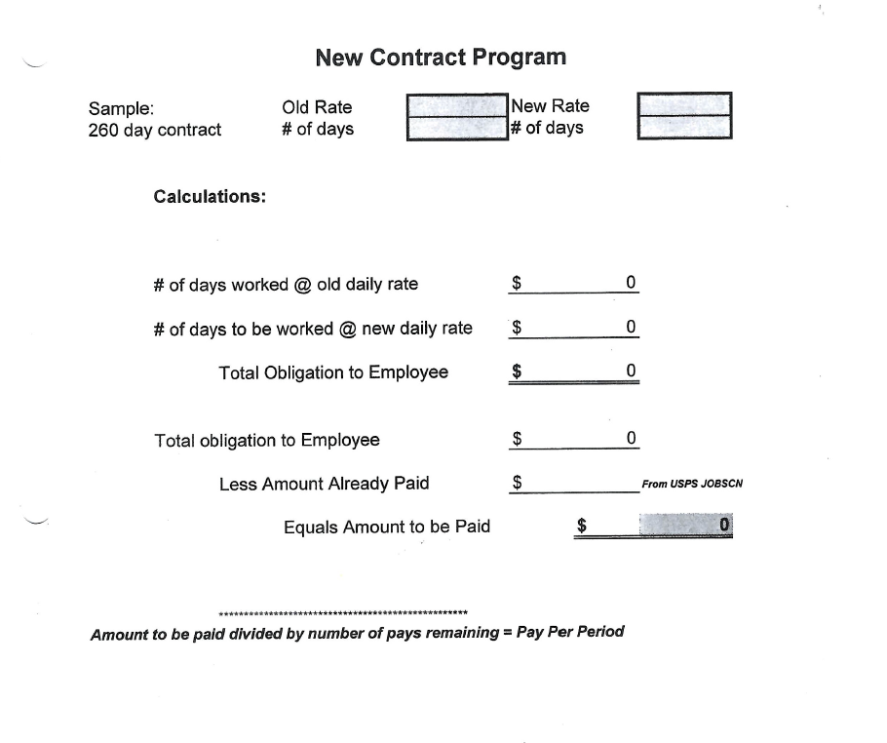
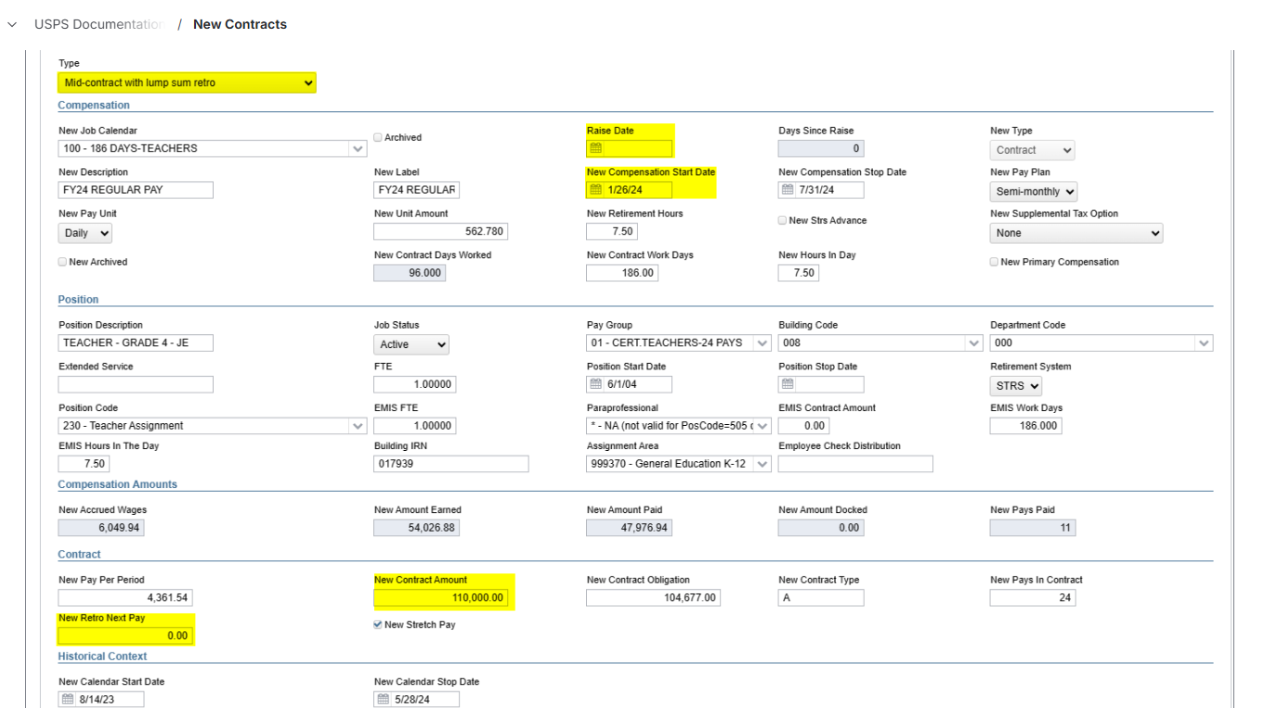
Mid-Year Contract Changes
System will calculate: Days since Raise, Obligation, Retro and Pay Per Period
What is the Raise Date?
What is the Annual Salary if it was for a WHOLE year?
Make sure OBLIGATION, Unit Amount, Pay Per Period are BLANK

Slide 24
PAYABLES
CORE- PAY ITEM CONFIG
TIMING
PROCESSING OUTSTANDING PAYABLES

Slide 25
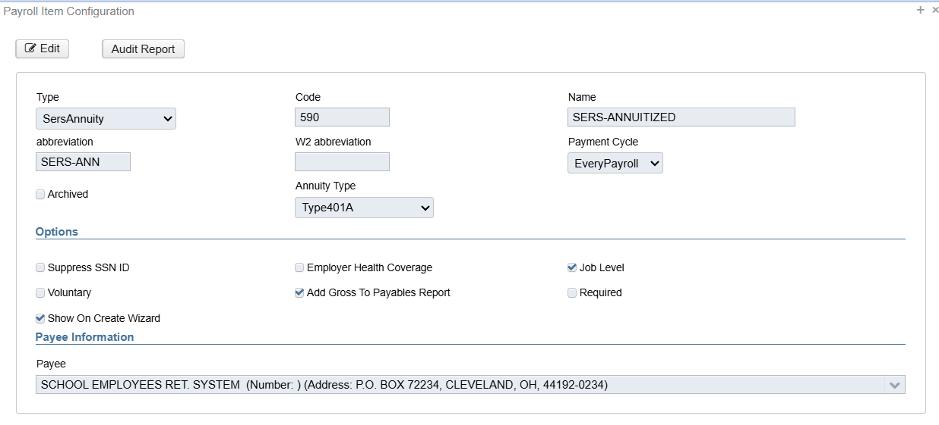
PAYROLL ITEM CONFIGURATION (CORE)
TYPE- Determines Taxing and Reporting
PAYMENT CYCLE – Remittance to Agency/not Withholding Cycle
EMPLOYER HEALTH COVERAGE – Part of the DISTRICT Medical Plan
JOB LEVEL – Can this Pay Item be accessed at the Job Level (STRS Pickup)
ADD GROSS TO PAYABLES REPORT – Should the Applicable Gross Wages be on the Pay Item Reports
REQUIRED – Is the Pay Item a required deduction for every employee
SHOW ON CREATE WIZARD – Pay Item will appear in Workflow/Onboarding of employees

Slide 26
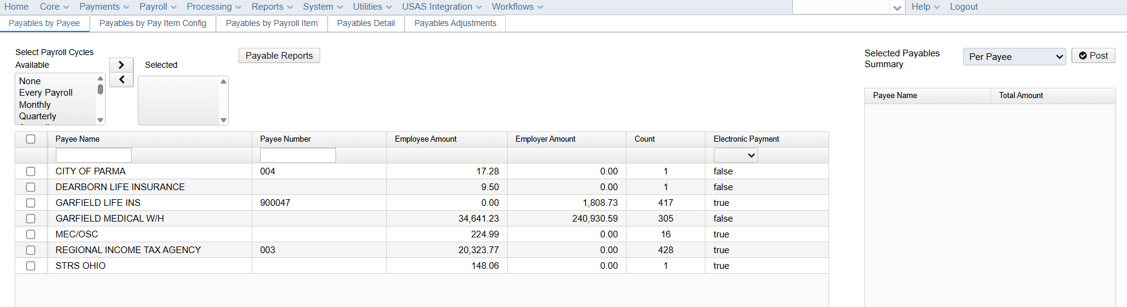
TIMING OF PAYABLES – COULD BE DIFFERENT THAN WITHHOLDING
POST PAYABLES WHEN PAYMENT IS REMITTED—NOT BEFORE

Slide 27
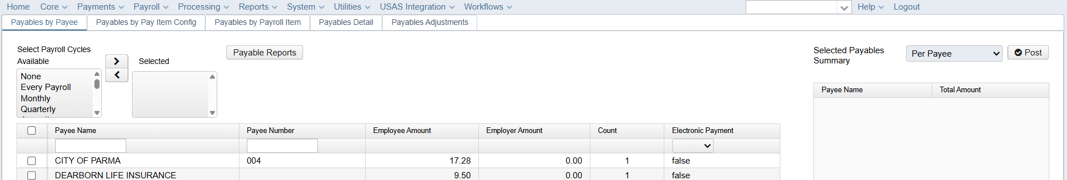
PROCESSING OF PAYABLES
SEVERAL OPTIONS TO REVIEW PAYABLES
BY PAYEE
BY PAY ITEM CONFIG (SUMMARY/TOTAL)
BY PAYROLL ITEM (EMPLOYEE AMOUNTS)
BY PAYABLES DETAIL (DETAILS OF EACH EMPLOYEE WITHHOLDING)
CAN RUN REPORTS (SUMMARY OR DETAIL)

Slide 28
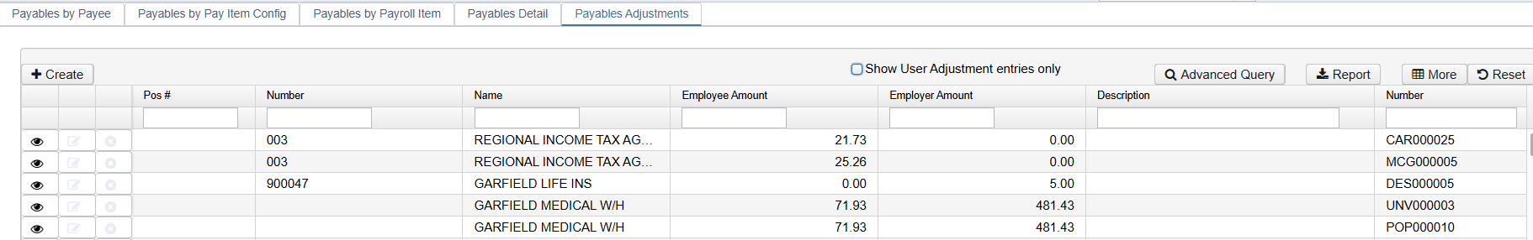
PAYABLES ADJUSTMENTS
USE CAUTION WHEN MAKING AN ADJUSTMENT
Should it NOT be remitted and given back to the employee?
Is a NEGATIVE amount being removed since it was returned to the employee?
How is this ADJUSTMENT being accounted for in the Bank?
Does this Adjustment Affect USAS?

Slide 29
OPEN
DISCUSSION
QUESTIONS

Slide 30
Thank you
SSA PAYROLL TEAM
Renee Brunner Anne Holton
Patti Weis Deb Carroll

